Slide 1
Proposal to design next generation cyber capabilities at Cigna
KPMG proposal to serve Cigna
Cyber Security Operating Model and Strategy
July 2022
SUBJECT TO KPMG RISK MANAGEMENT ENGAGEMENT ACCEPTANCE PROCESSES

Slide 2
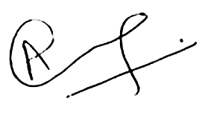
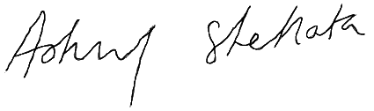
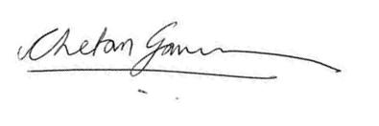
July 22, 2022
Dustin McCain/Lauren Insero Category Management Strategic Sourcing
Global Procurement | Third Party Management
Dear Lauren, Dustin,
On behalf of KPMG LLP, we are pleased to present this proposal to provide cyber security advisory services to Cigna. We recognize you are looking for a strategic cyber partner to develop a forward looking and operationally streamlined cyber capability. As you will see from our response and summary noted below, we feel that KPMG is the right strategic partner for you.
KPMG is the leading innovator in Security Target Operating Models. Our deep Security Target Operating Model experience enables KPMG to understand key success factors. One key success factor is to deploy a multidisciplinary senior team of cybersecurity, monitoring and detection, incident response, and data security experts.
Cigna and KPMG share a long-standing, valued relationship. KPMG has consistently over-delivered value to Cigna on some of the organization’s most important and strategic initiatives, including Project Dawn Transformation, Finance and Accounting Services and Client Service Transformation among various others listed on Slide 30.
Industry leading framework and accelerators. KPMG will expedite the delivery of this engagement through our industry leading frameworks for Security Target Operating models. These frameworks will guide not only business value creation through effective risk management, but also provide a comprehensive set of security mandates for operational coverage.
Extensive cyber security transformation implementation experience. We have proven credentials at Cigna’s direct peers that cover the same scope of work as proposed herein. We are also executing similar projects at other Fortune 50 organizations.
Our commitment to your success: We will invest in this project to drive success and transform your cyber security program. Ultimately, we measure our success by the only perspective that matters: yours.
We trust this proposal demonstrates how your requirements will be exceeded by KPMG. Please do not hesitate to call us with any questions.
Very truly yours,
KPMG LLP
Chetan Gavankar Engagement Partner
cgavankar@kpmg.com 617-650-3010
Anurag Rai Cigna Cyber Lead Partner
anuragrai@kpmg.com 630-346-5092
Ashraf Shehata
Cigna Global Lead Partner
ashehata@kpmg.com
513-763-2428

Slide 3

Contents
Topic | Page #
KPMG’s understanding of Cigna’s needs | 4
Differentiated experience | 5
We understand and know your security priorities | 6-7
KPMG’s insights on factors that put security operating models at risk | 8
Our qualifications | 9
Approach | 11-12
Project timeline | 13
Illustrative Deliverables | 14
Your Project Team | 16
Pricing | 17
Appendix 1 – Differentiators | 18
Appendix 2 – KPMG a Trusted Partner | 19

Slide 4
Introduction

Slide 5


KPMG’s understanding of Cigna’s needs
Cigna is looking to engage with a strategic partner to successfully refresh the cyber security operating model and strategy.
Cigna continues to disrupt the market as the purpose-driven global health services company
Key strategic questions KPMG will address with Cigna as we design your Security Target Operating Model
The transformation needs to equip Cigna to effectively defend against advanced threat vectors and secure an attack surface area that is expanding with the extreme velocity of digital transformation. This is even more significant as part of the organization level transformation that Cigna is undergoing since the launch of Evernorth.
How do we bring our broader stakeholders (technology, business, regulators, etc.) along with us on the journey?
What does the future-state look like across the layers of: organization, process and technology?
3
Which cybersecurity in-flight initiatives require recalibration or possibly redirection?
How do we keep security and enterprise transformations in-sync?
How do we reconcile change and culture?
How do we continue to protect Cigna against external threats and risks throughout the transformation?
2
KPMG is the strategic partner of choice for this journey. We have extensive cybersecurity transformation implementation experience.
What services need to be revised, established, or expanded in the near, mid and long term?
What will our detailed day-to-day transformation look like?
KPMG’s delivered Security Operating Model will address these primary domains and provide strategic direction to your Security Program.
Cigna has identified the need to strategically mature and transform its cyber security program to best-in-class to:
Stay ahead of the ever changing and advancing cyber threat landscape like ransomware and supply chain attacks
Look ahead and connect the healthcare and Digital Trust needs of your clients
Achieve proactive, transparent, strategic, and properly staffed and structured cyber organization
1
Identity & Access Management
Privacy
Governance and Organization
Data Protection
Software Security
Network Security
Architecture
Policy and Standards
Third Party Management
Threat Intelligence
BCP/DR
Physical Security
Vulnerability Identification and Remediation
Patch Management
Change Management
Asset Management
Security Monitoring
Incident Response
Configuration Management
Awareness
Metrics and Reporting
Strategy

Slide 6
KPMG will deliver a truly differentiated experience
KPMG understands your requirements to develop a next generation security operating model and strategy. As the market leader in security Strategy and Transformation we bring deep insights and enablers to help you achieve your aims. Through working with KPMG, Cigna will benefit from the following:
KPMG Commitment | Explanation
KPMG knows Cigna and come with deep insights into your strategic priorities. | KPMG is your trusted cyber advisor and we are currently delivering your Identity and Access Management transformation both on the workforce and customer side. We understand your cyber priorities and our proprietary frameworks bring speed and insights to operating model and strategy projects.
KPMG brings differentiated ways of working and will accelerate new perspectives on Cigna’s cyber operating model and strategy. | KPMG has invested in a suite of in-person and virtual collaboration tools, including KPMG Ignition Center. We will bring our virtual collaboration capability to this engagement to provide you with latest digital collaboration tools. KPMG Ignition Centers are collaborative events that accelerate design thinking and consensus building. This is critical to rapidly aligning on a “North Star” vision.
KPMG brings deep expertise into effectuating sustainable change through end-to-end operating model transformations. | KPMG has proven credentials at Cigna’s direct peers that cover the same scope of work as proposed herein. We have demonstrated our ability to effectuate sustainable change through taking a wide-reaching perspective into organizational drivers and structures. KPMG is currently engaged to provide similar services to 8 of the Fortune 50 companies.

Slide 7
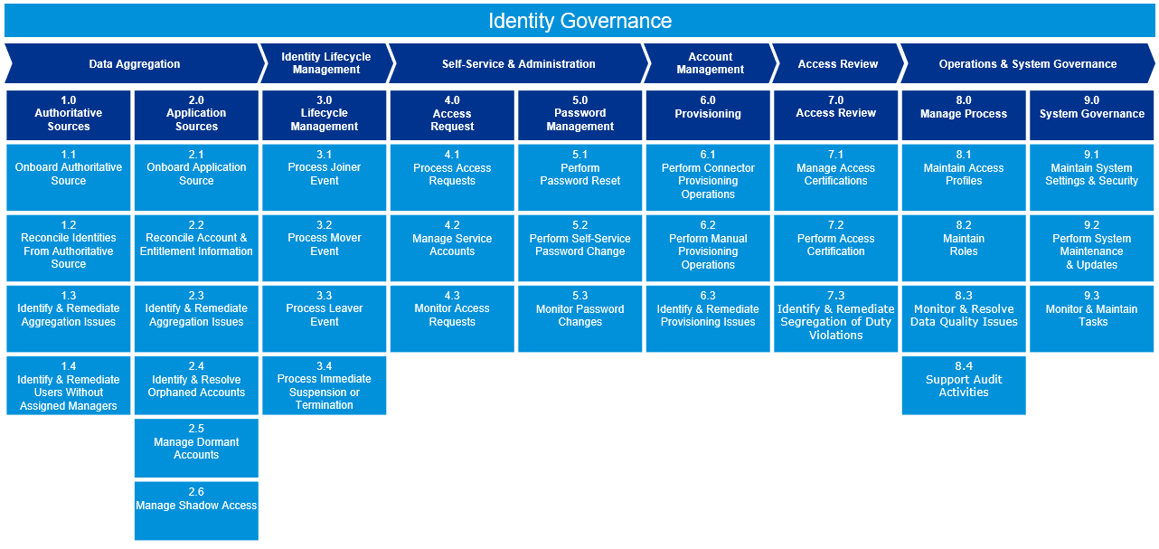
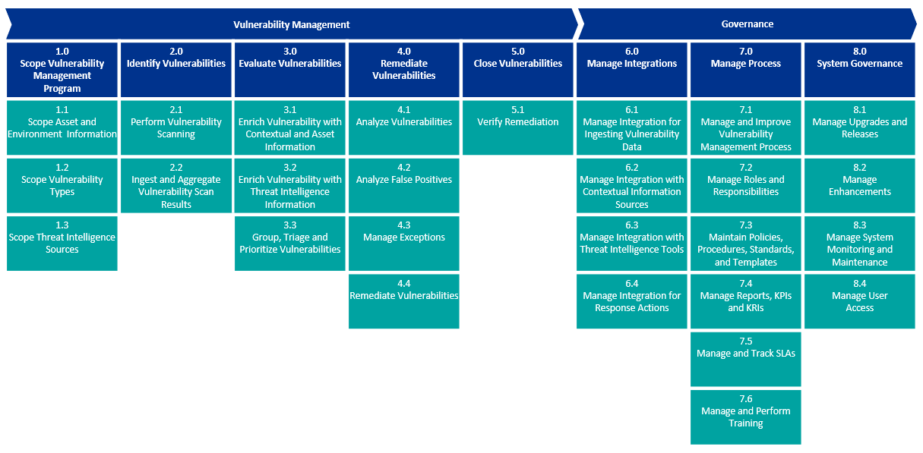
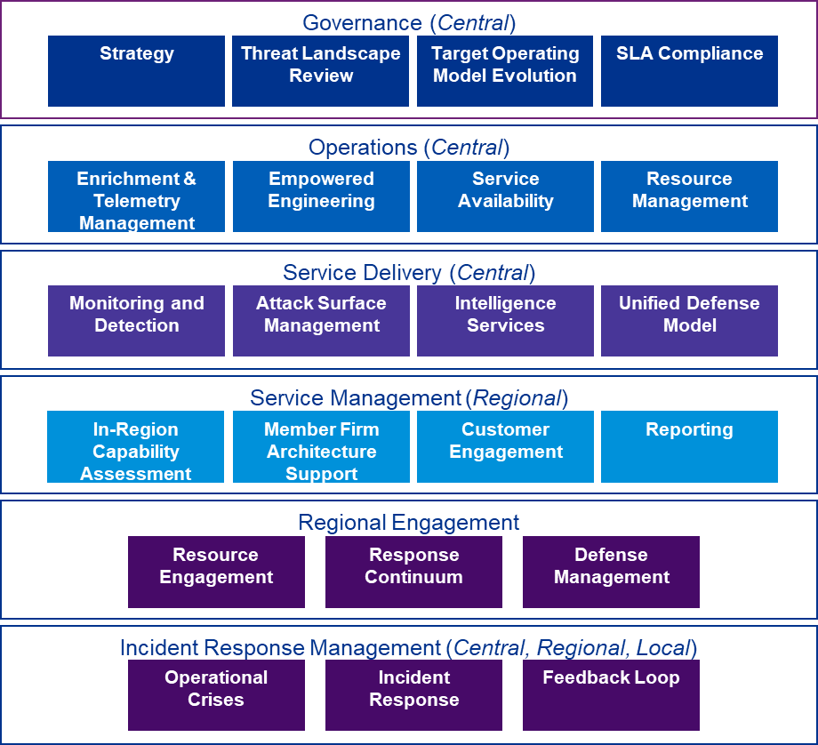
KPMG knows Cigna and comes with deep insights into your strategic priorities
KPMG is your trusted cyber advisor and we are currently delivering your Identity and Access Management transformation. We understand your cyber priorities and our proprietary frameworks bring speed and insights to operating model and strategy projects
Digital Identity Trust
Vulnerability Management
Monitoring and Response
In today’s world of Zero Trust, digital identities (and your ability to verify them) is an edge control that is essential to support digital delivery of services to the consumer.
The extreme velocity of technology change makes full lifecycle vulnerability management programs critical. They reduce successful attacks through defined processes for patch & configuration management.
Your ability to deliver monitoring and detection services is fundamental to addressing the evolving threat landscape, which includes addressing key security challenges and adding new capabilities.

Slide 8
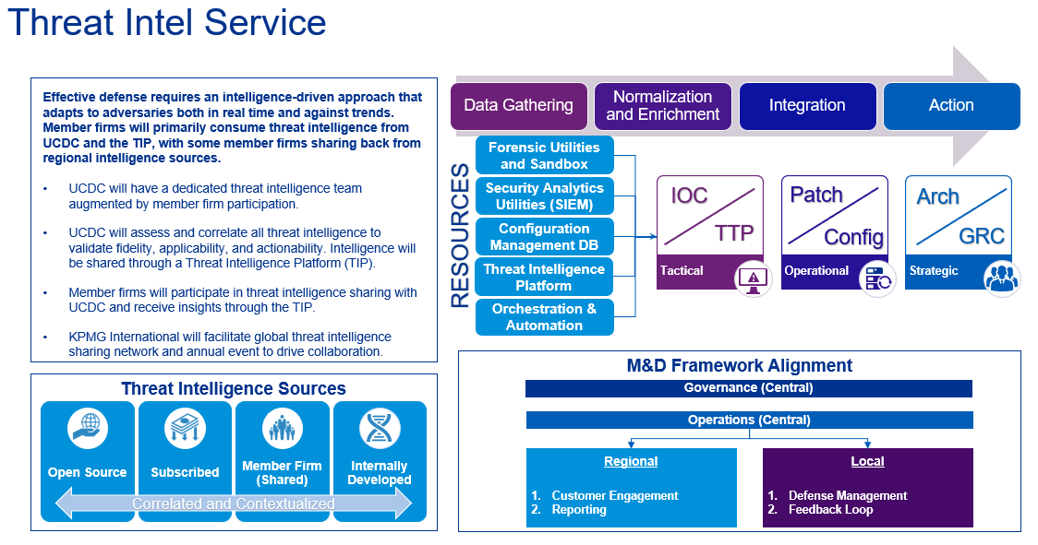
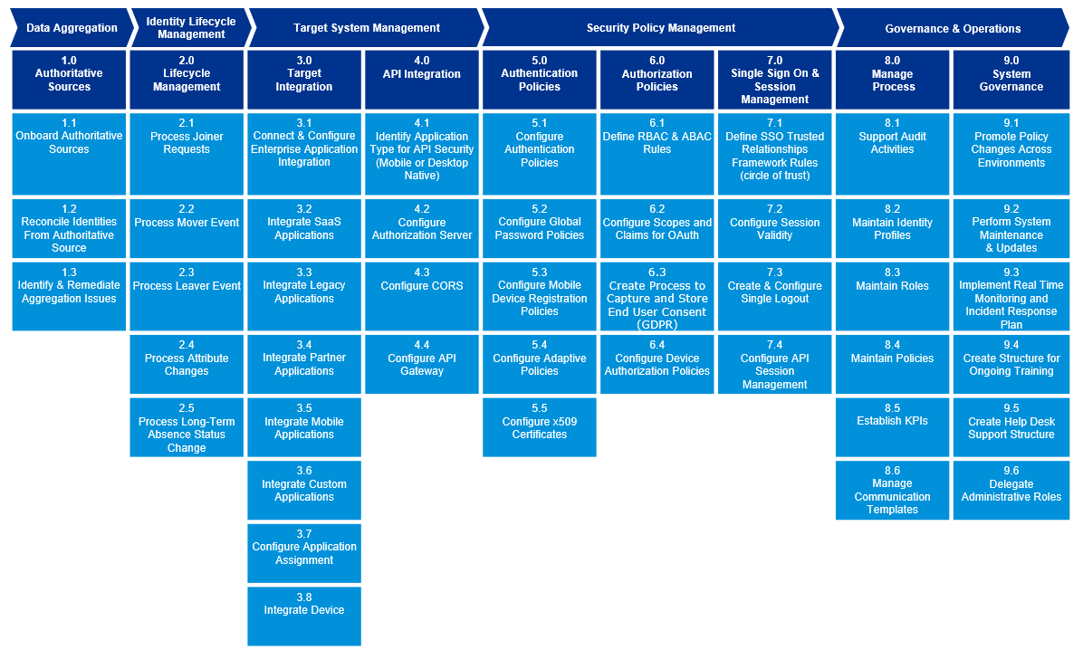
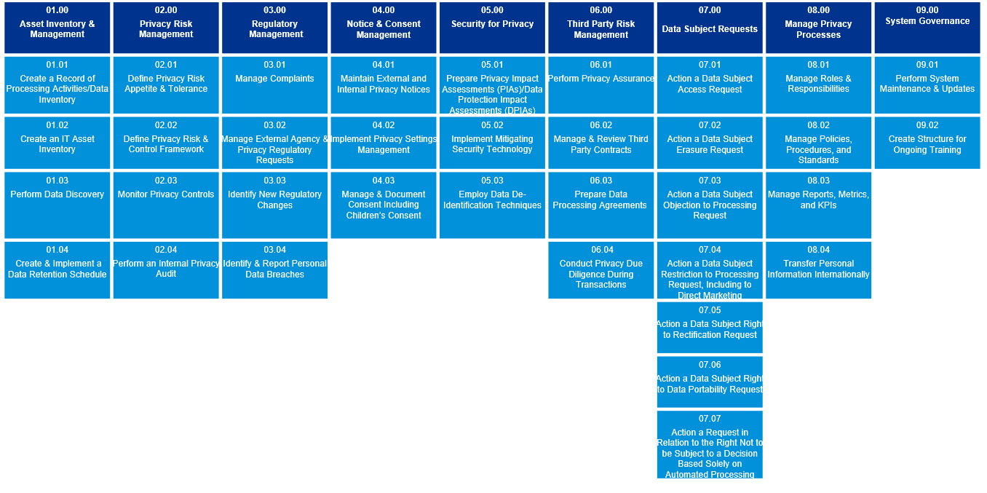
We know Cigna and come with deep insights into your strategic priorities (cont.)
Threat Intelligence
Access Control
Data Protection
Leading organizations define a cyber vision that moves the security posture from a proactive to a predictive cyber defense state
Similar to identity, authorization and authentication models are key to achieving zero trust principles
Protecting client and business critical data is at the core of our cyber strategy

Slide 9
KPMG’s insights on factors that put security operating models at risk
KPMG has successfully delivered numerous projects similar in nature to what we are proposing to Cigna. From our experience we have developed a set of insights.
# | Insight | How KPMG addresses this
1 | Misalignment – between business, technology, and security teams results in design gaps. | Facilitated collaboration: KPMG has built an industry-leading collaboration capability (“KPMG Ignition Center”). KPMG Ignition Center events leveraging diversity of thought to problem solve and agree on new ways of working. We activate Ignition Centers during cyber strategy projects to expedite the alignment process. Business-centric framework accelerators: KPMG’s Target Operating Model framework accelerators are structured to enable focus on specific commercial and risk drivers related. They also promote dynamism by design accommodate changes in the threat and business landscape.
2 | Institutional hostility – to change and internal political factors stalls strategy implementation. | Proactive engagement strategy: KPMG’s methodology for cyber strategy implementation centers around engaging a diverse set of stakeholders. In doing so, we cultivate a perception that change implementation is being done ‘with’ them not ‘to’ them. Our change experts apply various approaches to address this issue, including the use of our KPMG Ignition Center (described above).
3 | Talent – lack of security talent | Intelligent Resourcing Methodology: Only 30% of transformation projects succeed due to lack of security talent. KPMG will employ its Intelligent Resourcing Methodology in phase 1 to develop Recruiting, On-boarding and Off-boarding approach or framework
4 | Sponsorship – lack of executive sponsorship in the TOM results in strategic reprioritization. | Executive engagement strengths: KPMG repeatedly receives praise from Analysts for our ability to frame security initiatives in Board-level language. In the recent Forrester Wave™: Global Cybersecurity Consulting Providers we received the highest possible scores for business acumen; security strategy consulting capabilities; and governance, risk and compliance capabilities. This report also singled out KPMG for “…helping security leaders understand the next crisis, not just the current one”. Standardized reports and dashboards: KPMG has a pre-built set of templates which roll-up cyber strategy change management metrics from the execution level to the executive level.
5 | Narrow focus – on the functional processes inhibits operating model sustainability. | Holistic set of pre-packaged enablers: In addition to functional processes, KPMG’s Cyber Target Operating Model enablers cover People & Culture, Service Delivery Model, Technology & Tooling, Performance Insights & Data, and Governance. Inter-network teaming: KPMG fields teams which comprise expert practitioners from a broad set of backgrounds. This includes technical security professionals, people and change professionals, and transformation delivery professionals.
6 | Insufficient oversight – from Second and Third Lines of Defense during the strategy phase creates downstream blockers. | ‘How to engage’ toolkits: KPMG commonly observes gaps in the interaction model between the Second and Third Lines of Defense and cyber strategy teams. We have helped clients address this through our ‘How to engage’ toolkits which supports proactive reporting into the Risk and Audit functions.

Slide 10
KPMG is executing similar projects at eight Fortune 50 organizations
KPMG is the industry leader in cyber security transformation. We have proven credentials at Cigna’s direct peers that cover the same scope of work as proposed herein.
Fortune 50 Organizations | Relevant KPMG services delivered in the past 18 months
Organization A | Developed security target operating model with over 10 major global business units Developed service uplift for IAM, MDR, Incident Response and Managed Firewall Service Implementing MDR and IR transformation
Organization B | Independent oversight of consent order remediation activities spanning 100+ workstreams across Lines 1 and 2 – including effectiveness of design, strategy and architecture, process improvements and organizational change. Technology controls automation Cyber IA strategy advice
Organization C | Continuous monitoring and automation of risk metric reporting Strategy for next generation security operation and third-party risk management programs IAM platform design and build Security platform engineering Threat management operations
Organization D | Multi-year support on target operating model design and implementation including strategic planning, organizational change, security architecture and engineering, offshore and outsourcing strategy, and technology rationalization.
Organization E | Strategy for continuous monitoring, including integration with ServiceNow and the security data lake. Application onboarding Third party security program delivery
Organization F | Insider Threat Program Delivery Identity and Access Management transformation
Organization G | Lead integrator for digital transformation initiatives New product development including SecOps strategy, cybersecurity architecture, and anti-fraud controls
Organization H | Strategic partner for multi-channel convergence initiative Annual reviews of CIAM strategy including peer benchmarking, technology horizon scanning, cyber and fraud integration

Slide 11
Project approach & timelines

Slide 12
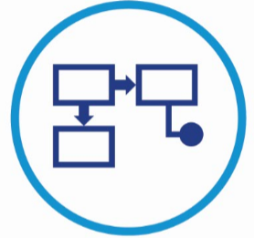





Approach
KPMG brings deep expertise into effectuating sustainable change through end-to-end operating model transformations. KPMG not only has service frameworks that define services but also has a leading Target Operating Model approach to define target state, define interaction models, develop a RACI and other project essential artifacts.
Implementing a operating model change will have impact well beyond the functional processes. Fundamental to all successful IT change programs is a strategic approach to managing the breadth of cyber security service.
Functional Process
People & Culture
Service Delivery Model
Technology & Tooling
Performance Insights & Data
Governance
The processes and interdependencies of the organization by which all work of the functioning enterprise is carried out, except for those that have been outsourced.
The structure, reporting and accountability hierarchy, capabilities, skills, culture and performance expectations for people and organizational units.
The locations and means by which services are delivered, ranging from decentralized to centralized, and whether these are in-sourced.
The information technology required by the organization to manage information/data and support the execution of processes.
The data and analytics required by the organization to support the execution of processes and inform the business of the success of the business initiatives.
The approach to align the organization’s governance, risk and compliance processes to its strategy, allowing for convergence and transparency of information to drive performance.
Multiple delivery pathways to deliver change
Consistent processes embedded across all services
Modern delivery
Cultural shift & new ways of working
Focus on talent management & retention
Change management and behavioural science as critical enablers
Agile sourcing approaches
Flexible supplier ecosystem
Driving performance and collaboration
Automation and standardization to drive efficiency and agility
Cloud-based, digital first
Optimization and rationalization
Performance aligned to business outcomes
Customer-centric
Digitally realized
Collaboration more important than hard boundaries
Governance to enable innovation and pace – balancing agility and risk
Decentralization of decision making: empowerment is key

Slide 13
Approach, continued
Our approach is to deliver the engagement over three phases across a total of 15 weeks. At the end of each phase we will provide deliverables with immediate realizable value to Cigna.
Discover (6 weeks)
Design (5 weeks)
Report and Socialize (4 weeks)
Aim
Activate the engagement in a way that sets the delivery team up for success.
Define the security operating model and strategy that enables a propulsion of Cigna into an industry leadership position.
Engage leadership and secure their support for operating model implementation and strategy adoption.
Key activities
Deliver engagement kick off
Undertake interviews and review documentation to augment existing institutional knowledge of Cigna cyber security organization
Conduct “North Star” lab to obtain directional alignment
Establish guiding principles for operating model and strategy
Bring in KPMG industry perspectives
Map in-flight initiatives to an industry leading framework
Obtain agreement on the high-level design for “North Star”
Define service delivery model
Define cyber strategy
Define TOM roles & responsibilities
Establish TOM goals, objectives, metrics/KPIs
Absorb enhancements for in-flight initiatives
Socialize TOM and strategy with stakeholders to gather feedback and closeout the engagement
Develop roadmap to assist execution of the strategy and implementation of TOM
Output
Voice of Customer Results
Current State Operating Model
Preliminary Current Security Capabilities
Target State Operating Model
Capability Delivery Model
High-Level Governance Model
Interaction Model through Prioritized Use Cases
Draft Cyber Strategy Document
Cyber Strategy Document
Cyber Security Roadmap
Executive Summary Report

Slide 14
Project timeline
We have outlined our key activities, deliverables, and milestones over the course the project.
 | Week 1 | Week 2 | Week 3 | Week 4 | Week 5 | Week 6 | Week 7 | Week 8 | Week 9 | Week 10 | Week 11 | Week 12 | Week 13 | Week 14 | Week 15
Program management
Discover
Design
Report & Socialize
Program management oversight/Weekly status updates
1
Analyze current cybersecurity operating model and strategy
1
2
Define future strategy and target operating model
2
3
Develop and executive summary reports
3
Color key
Design
Report & Socialize
Discover
Deliverables
1
Voice of Customer Results
Current State Operating Model
Preliminary Current Security Capabilities
2
Target State Operating Model
Capability Delivery Model
High-Level Governance Model
Draft Cyber Strategy Document
3
Cyber Strategy Document
Cyber Security Roadmap
Executive Summary Report
Dependencies
1
Access to stakeholders to understand current cybersecurity operating model and strategy
2
Buy-in from stakeholders on cybersecurity target operating model
Buy-in from stakeholders on cybersecurity strategy
3
Agreement on the finalized cybersecurity strategy and roadmap

Slide 15
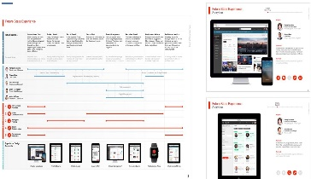
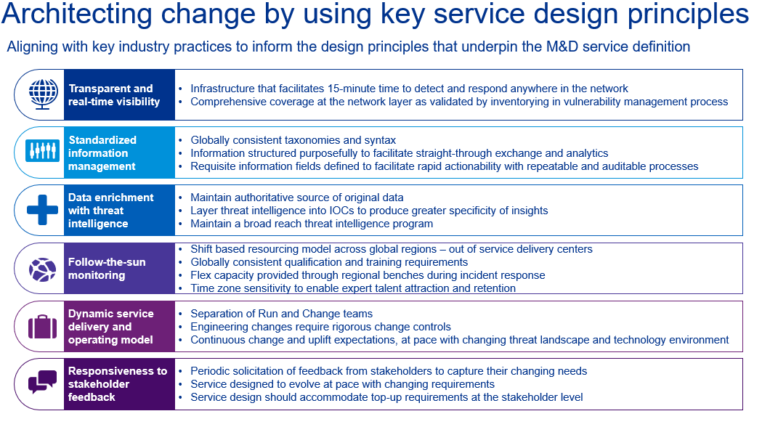
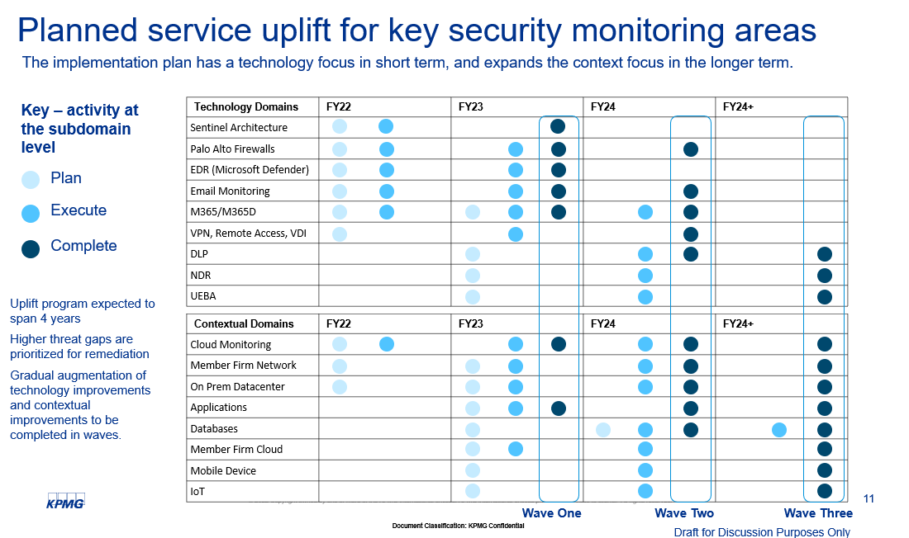
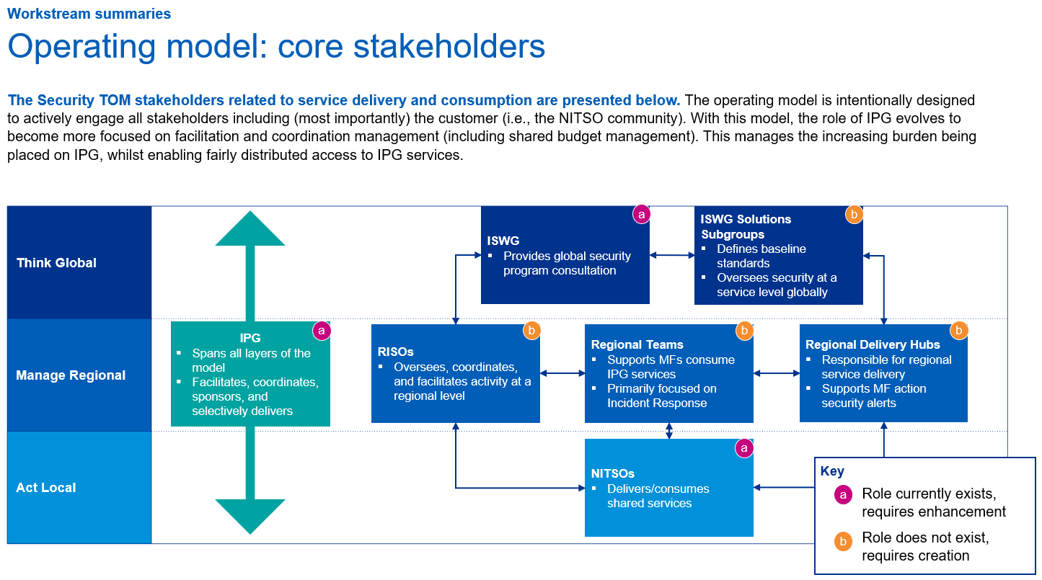
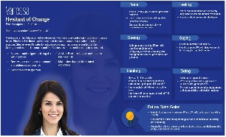
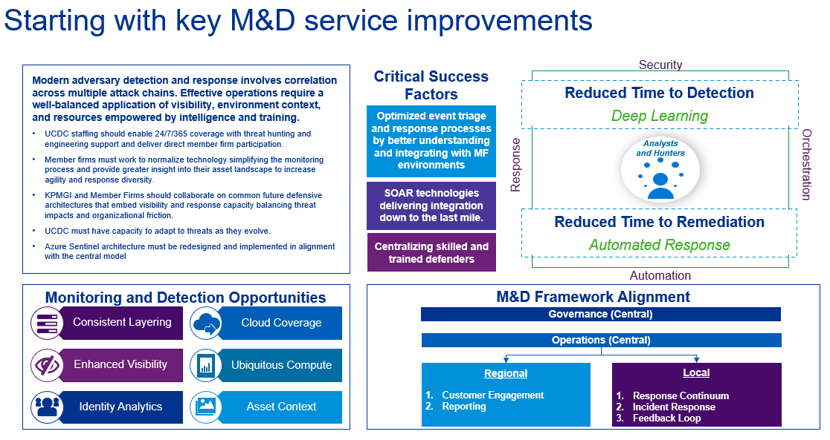
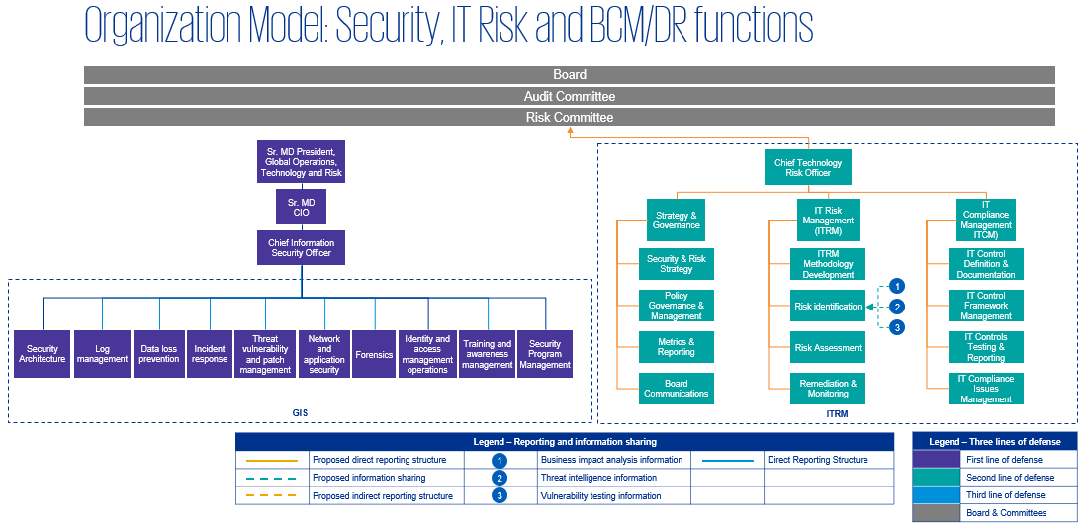
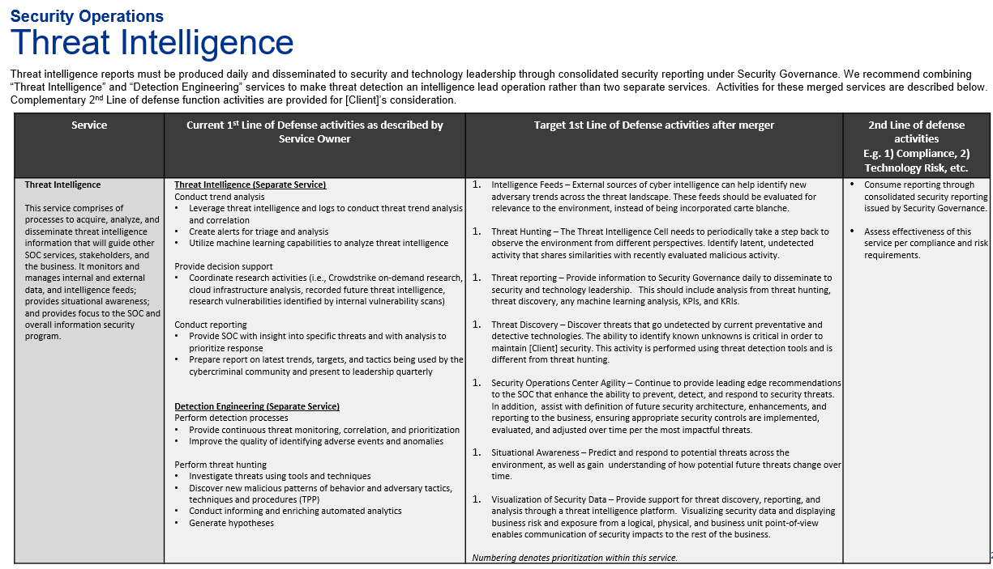
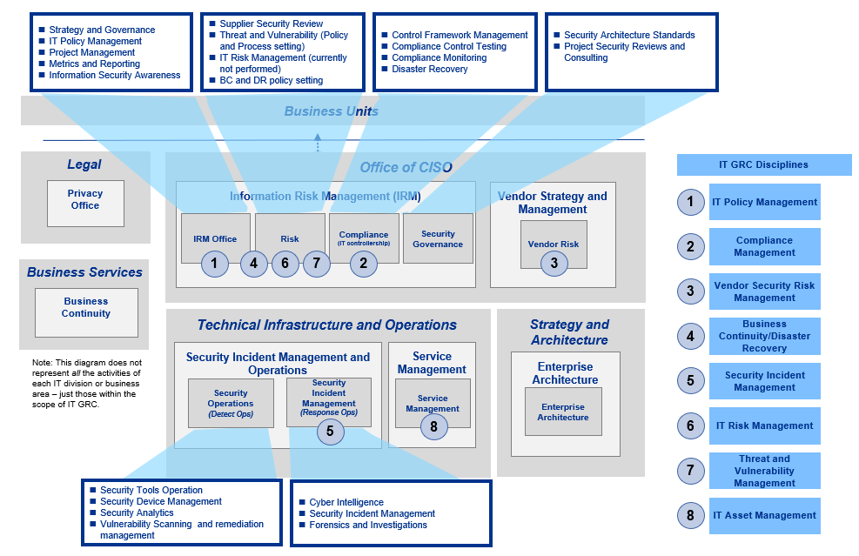
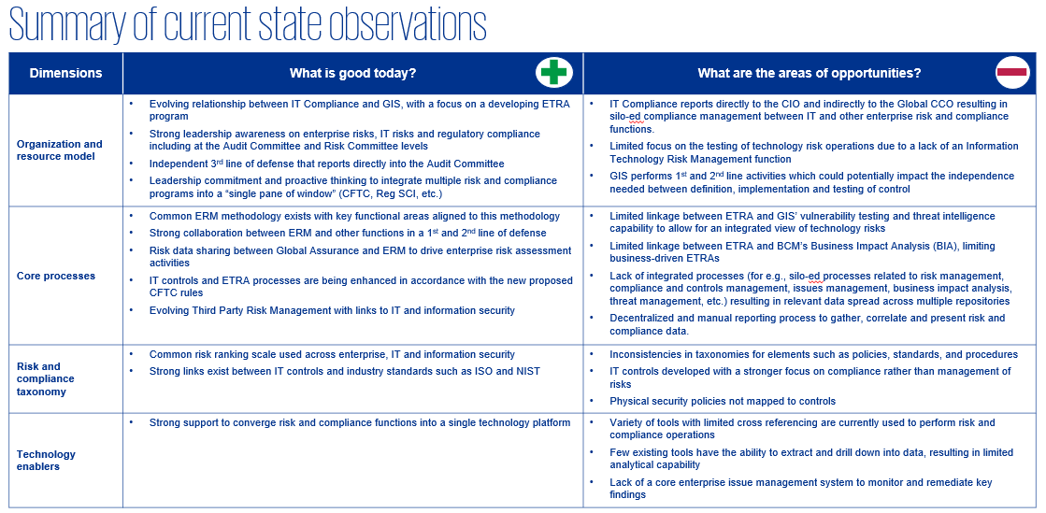
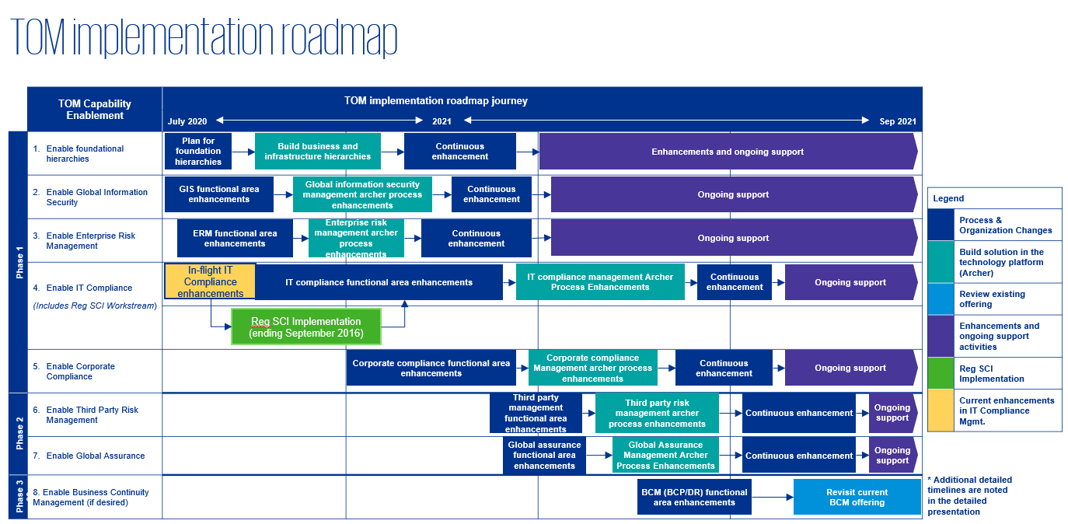
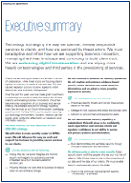
Illustrative deliverables
Discover (6 weeks)
Design (5 weeks)
Report and Socialize (4 weeks)
“Voice of Customer” Reporting
Target State Operating Model
Interaction Model through Prioritized Use Cases
Current State Operating Model
Capability Delivery Model
High-Level Governance Model
Preliminary Current Security Capabilities
Cyber Security Roadmap
Executive Summary Report

Slide 16
Team and pricing

Slide 17






KPMG’s team brings the business and technology expertise needed to ensure success
KPMG’s team is committed to Cigna’s success. We recognize that Cigna is executing a complex, multi-year org transformation – this requires a broad set of expertise. KPMG brings a team that collectively has the relevant specializations aligned with Cigna’s business vision.
KPMG Delivery Team
Chetan will be accountable for successful delivery of the engagement. He is the KPMG Solution Leader for Cyber Target Operating Models (design and implementation). He brings proven credentials in executing large scale transformation projects with significant impact on residual cyber risk and business value.
Shashanko brings his years of experience in Strategy and Governance, specializing in cyber risk management, program design and operational strategies. Shashanko will design and lead the engagement.
Patrick will bring their 8 years of experience across the entire cyber security portfolio across multiple industries with a specialty in implementation and execution of large cyber based products.
Chetan Gavankar
Cyber Target Operating Model Professional
Shashanko Roy
Engagement Delivery Co-Lead
Patrick Lloyd
Cyber Security Strategy and Governance Manager
Anurag has over 18 years of experience in information security, risk management, compliance, privacy and identity and access management domains and uses his experience to lead large scale cyber transformation efforts. He will bring that to guide the delivery team for Cigna
Karolina will lead the cyber roadmap delivery, coordinating and driving all aspects of cyber requirements implementation. She brings significant experience in supporting organizations with mapping of cybersecurity strategy with aligned initiatives and programs.
Rachida will perform day-to-day delivery of all elements of the engagement. Rachida has experience supporting and coordinating IT advisory engagements, with a focus on compliance monitoring. Her responsibilities included analyzing current governance model against its current capabilities to develop appropriate security measures to strengthen the IT state of the enterprise.
Anurag Rai
Cyber Lead Partner
Karolina Oseckyte
Cyber Transformation Delivery Lead
Rachida Kankpe-Kombath
Engagement Delivery Team member

Slide 18
KPMG’s commercial offer to Cigna
KPMG is excited to work with Cigna on this project as we support you in your cyber security transformation.
Professional services fee
Our professional fees for the services outlined in this proposal are as follows:
 | 15 Weeks
Professional Fees | $560,000
Less Investments | (100,000)
Total Professional Fees | $460,000
KPMG will invest $100,000 in this project.
KPMG will invoice Cigna only for delivered work.
Our content rich cyber strategy and implementation tools and accelerators will be leveraged during our work and are also included at no charge.
Based on our understanding of your requirements, we expect the engagement within 15 weeks.

Slide 19
Appendix 1: Key KPMG differentiators

Slide 20
Cyber target operating model

Slide 21
Cyber security – functional process model
Level 1
Security Operating Model
Level 2
1
2
Strategy, Governance and Policy
Culture, People and Skills
1.1 Security Strategy
1.17 Cyber Insurance
2.1 Approach to Embedding Security Culture
1.2 Policy & Standards Development & Maintenance
1.18 BISO & Business Unit Engagement
2.2 Enterprise Security Education & Awareness
1.3 Policy Oversight
1.19 RISO & Regional Jurisdiction Engagement
2.3 Mandatory Security Training Execution
1.4 Security Governance & Performance Management
1.20 Engagement with Second Line of Defence
2.4 Specialist Targeted Training & Awareness
1.5 Security MI Reporting & Metrics
1.21 Engagement with Third Line of Defense
2.5 Physical Security Training
1.6 Business Engagement
1.22 External Communications
2.6 Security Training Curriculum
Level 3
1.7 Regulatory Horizon Scanning & Impact Analyses
2.7 Security Education & Awareness Programmes
1.8 Regulatory Reporting & Engagement
2.8 Customer Security Education & Awareness
1.9 Technical Standards Development & Maintenance
1.10 Security Budgeting & Planning
1.11 Security Policy Embedding & Compliance
1.12 Security Governance Implementation
1.13 Security Reporting & Metrics
1.14 Data Governance
1.15 Data Privacy
1.16 Secure Integration / Separation (supporting M&A)

Slide 22
Cyber security – functional process model
Level 1
Security Operating Model
Level 2
3
4
Risk Management Framework
Identity, Authentication and Access Management
3.1 Security Control Framework Development & Maintenance
3.17 Measurement Engineering
4.1 Role Management Framework Development & Maintenance
4.18 Vetting of employees and contractors
3.2 Enterprise Cyber Risk Modelling & Assessment
3.18 Automated & Continuous Controls Monitoring
4.2 Role Implementation & Maintenance
4.19 Aftercare of vetted employees and contractors
3.3 Security Control Implementation and Operations
3.19 Cyber Framework and Obligation Mapping
4.3 Role Development & Maintenance
3.4 Exception Process Management
3.20 Risk Quantification
4.4 Identity Creation, Validation and Revocation
3.5 Physical Security Review
3.21 Cyber Value at Risk
4.5 Identity Request, Validation and Revocation
3.6 Risk Appetite & Limits Review
4.6 Access Provisioning & Deprovisioning
Level 3
3.7 Risk Reporting
4.7 Access Request, Validation and Revocation
3.8 Control Test Planning & Remediation Support
4.8 Privileged Access Management
3.9 Control Design
4.9 Toxic Combination Reviews, Investigations & Rule Configurations
3.10 Control Testing Governance & Reporting
4.10 Access Review & Recertification
3.11 Remediation Actions Arising from Control Testing
4.11 Information Asset Access Review & Recertification
3.12 Security Risk Identification, Assessment and Ownership
4.12 Physical Access Cards Provisioning
3.13 Non-Compliance Management and Enforcement
4.13 IDAM Policy Compliance Monitoring
3.14 IS Risk Advisory to Business
4.15 Physical Access Recertification
3.15 Thematic Reviews
4.16 Physical Access Control & Visitor Management
3.16 Control Op Effectiveness Testing
4.17 Access Endorsement

Slide 23
Cyber security – functional process model
Level 1
Security Operating Model
Level 2
5
6
7
Threat Intelligence and Investigations
Security Operations and Monitoring
Identifying and Managing Vulnerabilities
5.1 Intelligence Capability Management
6.1 Baseline Development & Maintenance
6.17 Alert Handling
7.1 Vulnerability Scanning & Identification
5.2 Strategic Intelligence
6.2 Use Case Development & Revalidation
6.18 Data Science & Data Engineering
7.2 Security Testing (Red, Purple, & Blue Teaming)
5.3 Tactical & Operational Cyber Intelligence
6.3 SIEM Data Onboarding & Monitoring
6.19 Cybersecurity Research
7.3 Threat & Vulnerability Triage & Advisory
5.4 Intelligence on Physical Security Threats
6.4 Security Event Reporting Process Management
6.20 Fraud and Fusion Centers
7.4 Vulnerability Service Management & Reporting
5.5 Threat Modelling (Profiling)
6.5 Anomaly Detection, Analysis & Triage
6.21 Cyber Resiliency
7.5 Vulnerability Remediation
5.6 Intelligence Collaboration
6.6 Insider & External Activity Monitoring
6.22 Tabletop and Simulation Exercises
7.6 Vulnerability Remediation (Fix) Review & Testing
Level 3
5.7 Technical Investigations
6.7 Malware Analysis
7.7 Penetration Testing Governance
5.8 Forensic Analysis
6.8 Safeguards for High Risk Individuals & Situations
7.8 Penetration Testing (BAU/ infrastructure)
5.9 Law Enforcement Partnerships & Liaison
6.9 Physical Security Monitoring
7.9 Penetration Testing (Project/ DevOps)
5.10 Threat Intelligence
6.10 Security Advisory to Incident Response & Management
7.10 Technical Surveillance Counter-Measures
5.11 Social Media Monitoring
6.11 Malware Containment
6.12 Security Logging & Monitoring
6.13 Security Orchestration, Automation & Response
6.14 Identification of High Risk Individuals & Situations
6.15 IT Asset Discovery & Management
6.16 Business Process Inventory

Slide 24
Cyber security – functional process model
Level 1
Security Operating Model
Level 2
8
9
10
Security Technology & Platform Management
Embedding Security in Change Control
Supply Chain and Third Party Security
8.1 Technical Security Controls Governance & Compliance
8.17 Security Systems & Tooling
9.1 Security Investment Strategy
10.1 Supplier Security Policy
8.2 Security Operations Tooling
8.18 Web Application Firewall & Internet Gateway Mgmt.
9.2 Security Investment Planning
10.2 Develop Supplier Security Standards
8.3 DLP Configuration & Management
8.19 Cryptographic Compliance
9.3 Security Change Delivery
10.3 Apply Supplier Security Segmentation Standards
8.4 E-mail Protection
8.20 Physical Security Solution Management
9.4 Security Architecture and Design Development
10.4 Third-Party/Supplier Risk – Proactive Monitoring & Response / Investigation
8.5 Web Content Filtering Management
8.21 Cloud Security Management
9.5 Core Security Design Assurance
10.5 Supplier Control Review & Assurance
8.6 Malware Security Solution Management
8.22 OT Security Operations
9.6 Security Component Solution Design
10.6 Supplier Assurance & Management
Level 3
8.7 Identity Tooling & Engineering
8.23 Mobile Device Solution Management
9.7 Security Design & Build Process Oversight
10.7 Input into Onsite Supplier Assurance Reviews
8.8 Data Loss Prevention Solution Management
8.24 IoT Device Solution Management
9.8 Application Change Governance
10.8 Supplier Risk Rating based on Assurance Findings
8.9 Cryptography Solution Management (Certificate Generation)
9.9 Application Security Requirements
10.9 Oversight & tracking of remediation actions arising from Supplier reviews
8.10 Cryptography Solution Management (Governance & PKI)
9.10 Secure Coding Standards
10.10 Sec Threat/Incident Support for Suppliers
8.11 Endpoint Security Solution Management
9.11 Security Investment Portfolio Management
10.11 Suppliers Issues Exception and Acceptance Standards and Procedures
8.12 Mainframe Security Solution Management
9.12 Specialist Security Advice for Change Projects
8.13 Server Security Solution Management
9.13 M&A Security Strategy
8.14 Security Ruleset Maintenance (e.g. DLP)
9.14 M&A Security Oversight
8.15 Network & Perimeter Sec. Solution Management
9.15 SecDevOps Automation
8.16 Automation & Optimisation

Slide 25
KPMG Ignition Center

Slide 26
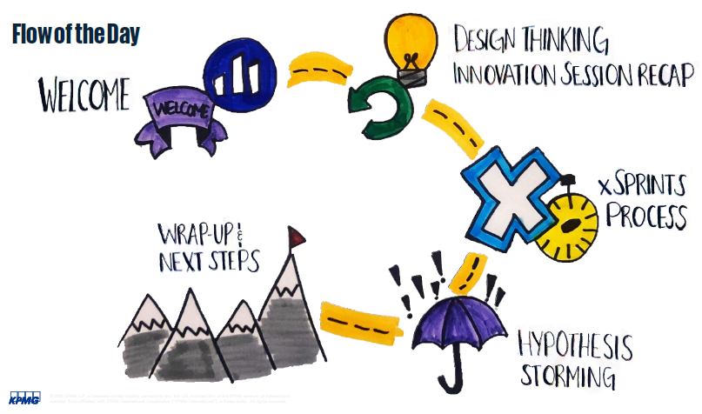
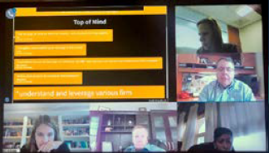
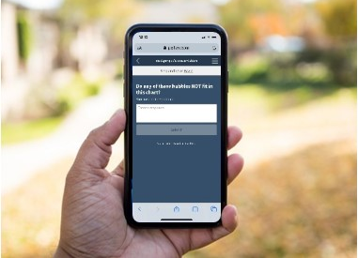
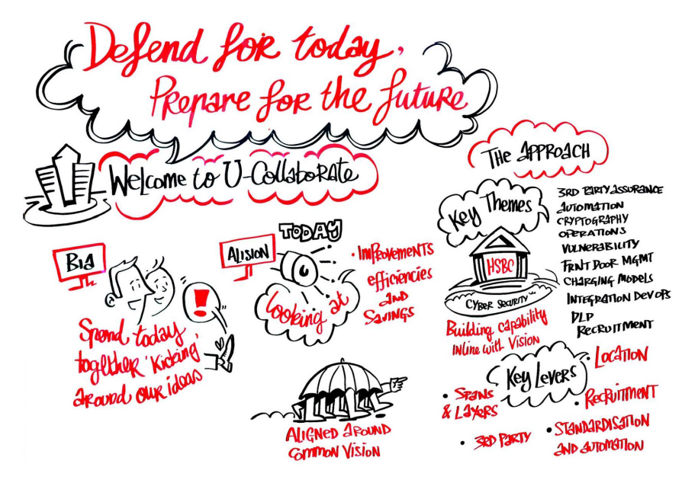
KPMG brings differentiated ways of working and will accelerate new perspectives on Cigna’s cyber operating model and strategy
KPMG has invested in a suite of in-person and virtual collaboration tools, including KPMG Ignition Center. We will bring our virtual collaboration capability to this engagement to provide you with latest digital collaboration tools.
Our team creates an engaging environment needed to foster collaboration.
Representative output
KPMG Ignition Centers enable you to create momentum and drive mission critical and organizational priorities. This includes:
Visioning: We will help Cigna envision their future state with unparalleled speed and insight.
Innovating: We will help Cigna think like a startup whilst you continue with your industry leadership
Leading: We will help Cigna succeed at this pivotal moment in your enterprise.
KPMG Innovation Centers produce tangible, outcome- driven deliverables to drive decision support and actionable next steps. They capitalize on the speed of collaboration by reducing cycles required from linear working approaches.
Collaboration session agenda
Collaboration session in progress
What are the benefits of a KPMG Ignition Center session?
What is included in a KPMG Ignition Center session?
Coordinated Ignition Team with extensive facilitation and collaboration expertise
“The Engine Room”
Technology requirements & support
Custom agenda design and execution
Relevant assets and methods
Relevant insights
Output package
Host & Connect using tools to provide an intuitive user experience
Share content in a secure cloud environment via tools like Microsoft Teams or client preferred collaboration platforms. We provide flexibility to display a wide variety of content while being platform agnostic
Collaborate leveraging software products that enable us to enhance our activities though real-time collaboration
Interact using tools such as Poll Everywhere, allowing participants to easily interact directly and in the moment
Real-time survey tool
Output deck
Example technologies and resources

Slide 27

KPMG’s Global Ignition Centers drive and accelerate innovation
Our team creates an engaging environment needed to foster collaboration.
Areas where we can help include:
When you need to bring leaders together to solve mission critical problems
When you have projects that are stalled or in danger of derailing due to travel restrictions and work from home policies
When you are facing complex technical and operational challenges
When you need to re-prioritize or realign around new or different key initiatives
When you need to mobilize and enhance your workforce with virtual capabilities required to run day-to-day activities
When you want to understand how to leverage analytics, or explore emerging technology and AI and how they might apply to your business
When you are seeking to improve efficiency through automation

Slide 28

Our formula, designed for you
We design a customized experience to address evolving and unique challenges.
Environment
We create an environment to enable your teams to address complex problems, and we manage the tools and process so you don’t have to.
Methodologies
We help you innovate and accelerate – by design. Both are critical in the current environment and we have adapted our capabilities to be run in virtual/in-person hybrid.
Talent
Our engine room enables sessions consisting of all necessary roles, ranging from facilitation and strategic intelligence to data & analytics to technology and beyond.
Assets
We have a broad base of strategic intelligence, insights, data & analytics stories and demos, and solutions.

Slide 29

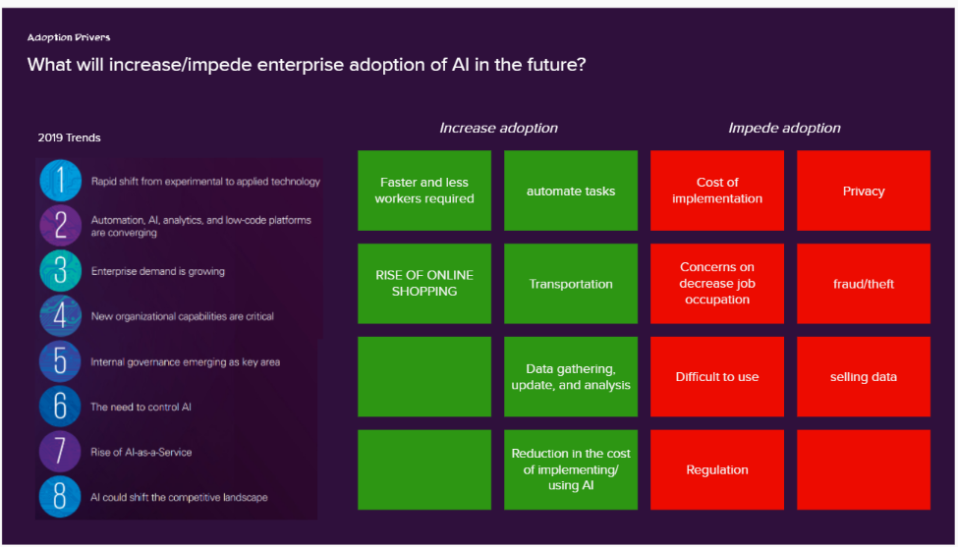
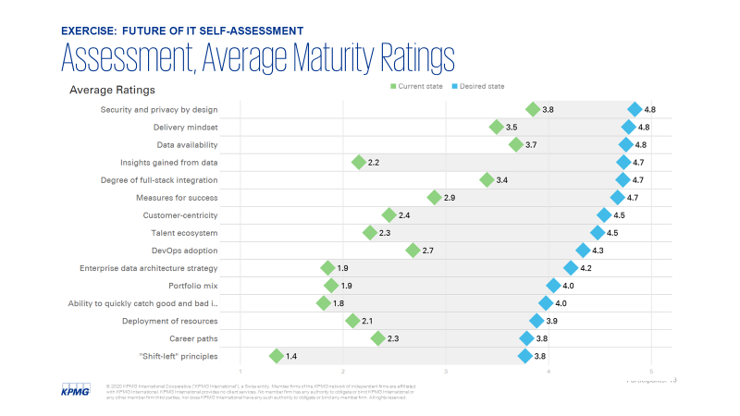
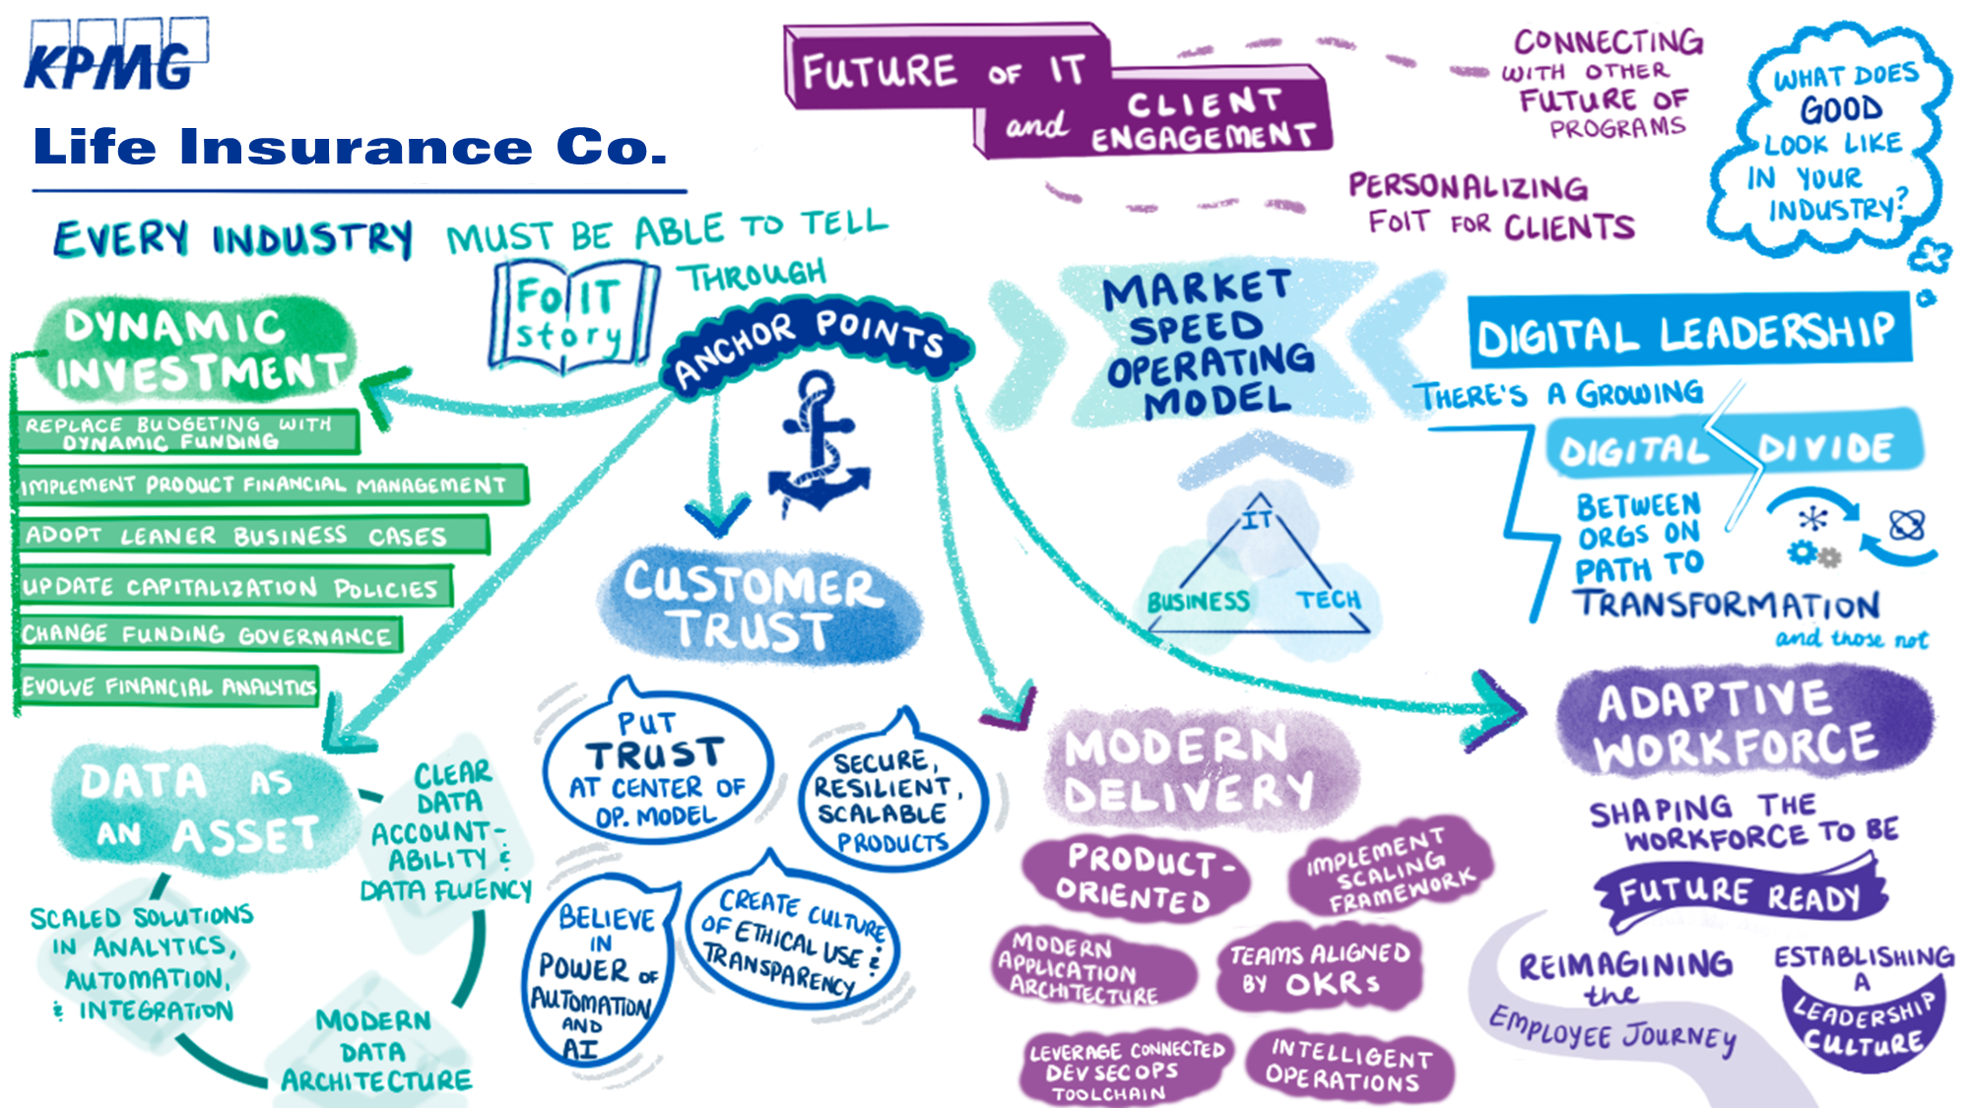
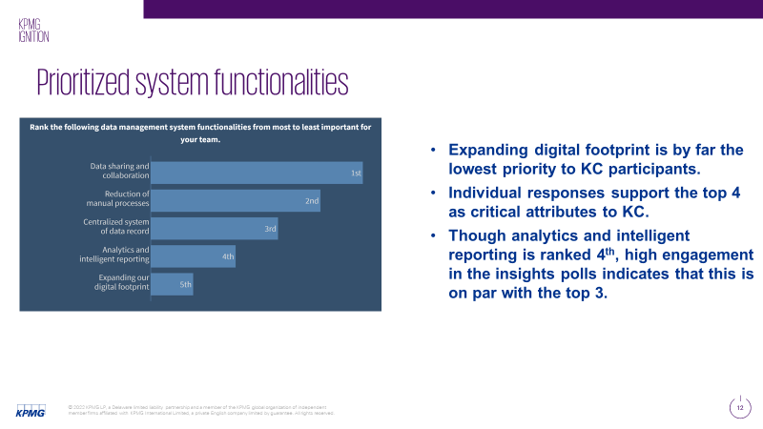
Sample session outputs
Session highlights
Interactive activities
Visual capture
Exercise results & analysis

Slide 30
Appendix 2: KPMG’s trusted relationship with Cigna

Slide 31
Supporting with purpose
KPMG is keenly focused on supporting Cigna's growth with purpose, aligning with your values and helping you be champions for affordable, predictable, simple health care. We are proud of our net promoter scores for the service we have delivered. Below are highlights of the key projects that we have completed or are currently engaged to serve.
2020–21
Cyber/IT
IAM transformation support
Cyber metrics program assistance
Information Technology
RPA PMO support
Data migration to the cloud
Persistent dynamic funding
Finance
Valuation & accounting advisory services
Finance enablement – EBS cloud planning
Finance integration support
Leasing tool implementation
Accounting advisory support
Intercompany transformation support
Orange to blue book conversion
2019
Sales & use tax compliance
Identity & access management support
Tax
Global tax compliance & transfer pricing services
Sales & use tax compliance
Tax integration support
State tax return review
Tax restructuring
R&D tax credit
PBM pricing template automation assessment
Project lightning accounting support
PBM study analysis
Global tax compliance & transfer pricing services
2018
Operations Client service transformation design and implementations
SOC2 readiness assessment
CVS marketshare review
Client service transformation design and implementation
Valuation Services
Building Finance Foundation & Finance Program support
ADA compliance assessment
Intelligent Automation COE design and implementation
2008–17
Sales & use tax compliance support
Technical accounting support
Client & third-party audit support
Identity and access management support
Legal entity simplification
Privileged access design and implementation
Legend:
Cigna
Ongoing project
ESI
Ongoing project

Slide 32
Proudly serving Cigna
Contract lifecycle management
Simple. Aging legacy system, disconnected manual process, and complex products were negatively affecting the client experience at ESI. We redesigned your business processes and partnered with Stratera to deploy innovative Apttus CLM technology. By helping you view the customer experience as a unified journey, we were able to help you transform the client experience to continue delivering market-leading quality with improved speed and value.
IAM transformation support
R&D tax credit
Cyber metrics program assistance
Global tax compliance and transfer pricing services
Affordable. Established single points of contact at Cigna in each of the 18 countries to coordinate and provide non-U.S. direct and indirect tax compliance and preparation of transfer pricing documentation. We have been able to help you standardize processes thereby driving efficiency and cost savings.
Tax restructuring
State tax return review
RPA PMO support
Technical accounting support
Predictable. Provide specialized accounting support through the launch of the Ascent GPO. We continue to serve as trusted advisors based on our long-standing relationships and understanding of the complexities within the business.
Tax integration support
Valuation & accounting advisory services
Sales & use tax compliance
Finance enablement – EBS cloud planning
Affordable, Simple. We were hired to help you understand the drivers of the Specialty Pharma PMPMs over time, specifically to assist the pricing team in developing a new product. While working closely alongside your team, we developed regression models and made recommendations for future extensions which will aid in data migration for on-prem to the cloud. We shared proof of concepts with you which will ultimately help you to minimize costs of expensive applications.
Data migration
Global tax compliance & transfer pricing services
Finance integration support
Dynamic funding
Affordable, Predictable, Simple. In the midst of an agile transformation journey, you recognized the ability to manage investments dynamically as an imperative. We partnered with you to frame, design, pilot, and implement a funding model for technology investments. Our team took an agile approach to stand up the new funding model in a series of iterative releases in parallel with the existing planning and budgeting cycles and assisted the client with a transition plan to address the evolution of new governance forums, roles, and enabling artifacts.
Client service transformation design and implementations
Leasing tool implementation
Orange to blue book conversion
Accounting advisory support
Intercompany transformation support
Identity access management transformation
Affordable, Predictable, Simple. As a result of a Cyber Maturity Assessment and previous work with ESI, we are supporting improvement activities within the entire organizations IAM stack to enable Cigna to function without any limitations around access and people while keeping data security and broader cyber risks in mind.

Slide 33

Cigna and KPMG: Aligned on Values
KPMG’s culture of heads-up thinking and its five core values align well with Cigna’s values: we are mutually committed to do the right thing for our communities; practice inclusiveness and celebrate diversity; act with courage to think beyond convention and be innovative; deliver excellence in all we do; and bring value to those we serve and represent, by doing what matters.
Cigna Values
We care deeply about our customers, patients, and coworkers
We partner, collaborate, and keep our promises
We innovate and adapt
We act with speed and purpose
We create a better future together
KPMG Values
Integrity – we do what is right
Together – we respect each other and draw our strength from our differences
Excellence – we never stop learning and improving
Courage – we think and act boldly
For better – we do what matters

Slide 34
Shared focus and diversity commitment
It is no surprise that Cigna and KPMG work so well together. We both share a deep, powerful commitment to the highest principles of corporate values and culture. It is about doing good — for our people, our communities, the environment, and the future. We do not just talk about these principles — we live them each and every day. And we are proud to work with Cigna, who shares these same corporate values.
Cigna
KPMG
Diversity networks
Diversity networks Business Resource Groups (BRG)
African American/Black
Aspire (Asian/South Asian)
Juntos (Hispanic/Latino)
Generations (Multigenerational)
Pride (LGBTQ+)
ABLE (Achieving Better Lives for Everyone)
Salute (Veterans)
UpLift (Interfaith)
UpNext (Career mobility)
Virtual
WIN (Women Influencing and Networking)
KPMG Network of Women (KNOW)
Veterans
Pride
Asian Pacific Islander
Abilities in Motion
African Ancestry
Hispanic Latino
Inclusion Councils
Core values
Corporate values
We care deeply about our customers, patients, and coworkers
We partner, collaborate, and keep our promises
We create a better future—together
We act with speed and purpose
We innovate and adapt
Integrity: We do what is right
Excellence: We never stop learning and improving
Courage: We think and act boldly
Together: We respect each other and draw strength from our differences
For Better: We do what matters
Cigna Foundation and Piedmont Heart Institute
KPMG and American Heart Association
To help raise awareness of heart health risks, especially among women, the Cigna Foundation has teamed up with Piedmont Heart Institute. By providing a $449,000 grant, the Cigna Foundation is helping Piedmont Heart Institute expand its Women's Heart Program to additional communities in Georgia, allowing more at-risk women to access holistic cardiovascular care.
KPMG is proud to support the American Heart Association (AHA) and its work to help us all live healthier lives free of cardiovascular diseases and stroke. KPMG partners and employees support the AHA through Heart Walks, Go Red for Women, Heart Balls, Little Hats Big Hearts, and Cycle Nation with over $787,012 total contributions.

Slide 35
Contact us
Chetan Gavankar Principal, KPMG LLP Cell: 617 650 3010 Email: cgavankar@kpmg.com
kpmg.com/socialmedia
The information contained herein is of a general nature and is not intended to address the circumstances of any particular individual or entity. Although we endeavor to provide accurate and timely information, there can be no guarantee that such information is accurate as of the date it is received or that it will continue to be accurate in the future. No one should act upon such information without appropriate professional advice after a thorough examination of the particular situation.
© 2022 KPMG LLP, a Delaware limited liability partnership and a member firm of the KPMG global organization of independent member firms affiliated with KPMG International Limited, a private English company limited by guarantee. All rights reserved.
The KPMG name and logo are trademarks used under license by the independent member firms of the KPMG global organization.
Restriction on Disclosure and Use of Data – This document contains confidential or proprietary information of KPMG LLP, the disclosure of which would cause irreparable harm to KPMG LLP; therefore, the recipient shall not disclose, use, or duplicate this document, in whole or in part, for any purpose other than recipient's consideration of KPMG LLP's proposal.

